Slide 1

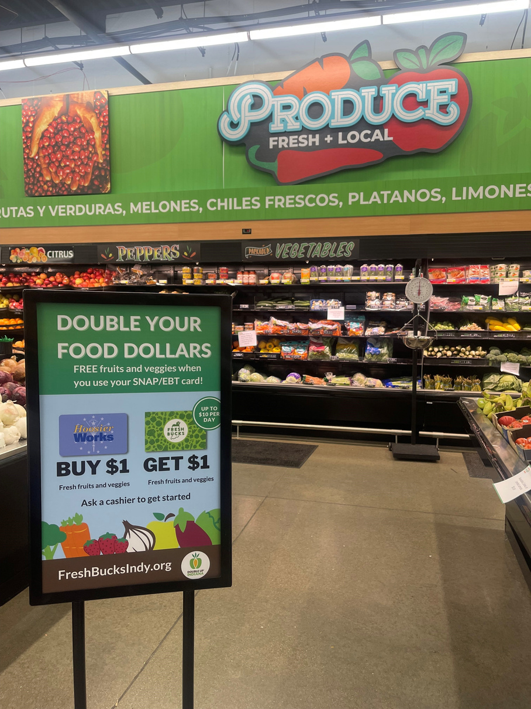
DOUBLE UP INDIANA
2025 Indiana Overview
Double Up Indiana matches SNAP spent on fresh fruits and vegetables while supporting Indiana farmers.
Double Up is a Win/Win/Win:
It helps families bring home more fruits and vegetables, boosts business for Indiana farmers, and ignites local economies.
Indiana uses a hub & spoke model to strengthen regional reach including expansion into rural areas.
51
Participating locations!
$202,407 Total Economic Impact in 2025
This includes the increased household purchases of fruits and vegetables and the re-spending of those incentive dollars in the economy by Hoosiers and businesses among the local food system.
“Participating in Double Up Indiana has created a more welcoming and accessible market environment for SNAP shoppers. The program not only supports food access, but also strengthens connections between local farmers and the community. During the first season we participated in Double Up we saw an over 1200% increase in SNAP redemption. It’s a wonderful program that has helped us better meet a need in our community.”
— Nanci Sears Perry, Yorktown Farm & Artisan Market
$133,884.50 redeemed using Double Up Incentives
$39,357 at brick & mortar sites
$94,527 at farm direct sites
SNAP matching programs have been in Indiana since 2013. In 2022, the St. Joseph Community Health Foundation in Fort Wayne received a GusNIP grant to implement the Double Up Food Bucks program. In 2023, they partnered with the Indiana Department of Health to expand the program statewide. By 2025, the Department took on administrative responsibilities to further develop Double Up Indiana in collaboration with regional organizations.

Slide 2
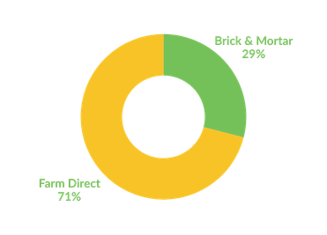
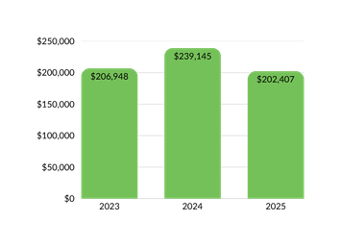
Today, Double Up is a statewide success powered by federal, state, and philanthropic support. It is also a national model for healthy food incentives.
Shaping Public Policy
Double Up’s track record of positive impact for families and farmers helped make federal support for incentives a permanent part of America’s farm bills.
Looking Forward
Some of our goals for the future include:
  Scale Double Up Indiana across the state at farmers markets and local retail sites.
  Enhance communication efforts to increase awareness of Double Up Indiana to increase utilization.
  Evolve redemption processes by transitioning to electronic incentives (e-incentives).
  Conduct an EBT integration feasibility study through the Rural Health Transformation Program (RHTP).
  Enhance evaluation and data collection to measure long-term impact on food access, local economies, and household nutrition.
  Strengthen year-round and rural community access through additional local food retailers (grocery stores).
2025 Highlights
$202,407 Total Economic Impact for Hoosier families and businesses
More than 4,044 individual SNAP households were reached
More than 181 Indiana farmers benefited from Double Up
The Indiana Department of Health was awarded the USDA Gus Schumacher Nutrition Incentive Program (GusNIP) grant which will allow the program to expand, increasing the number of locations and rural reach.
Double Up Sales in Indiana
Economic Impact
Due to federal funding changes and disruptions of SNAP with the federal shutdown in 2025, SNAP sales were impacted across the nation.

